Slide 1


Predictive Model for Pricing Used Vehicles
a presentation by Kelly Goforth
‘
S
Cars4U
2021

Slide 2
Project Goals
• Clean, analyze, visualize, and refine the data in order to identify patterns and trends to build a dependable model.
• Develop a sound and reliable predictive method to accurately estimate pricing for used vehicles.

Slide 3
Model Data
• 5068 usable rows of data
• 12 meaningful columns of information
- Make - Fuel Type - Engine
- Year - # of Owners - Power
- Mileage - Transmission - Location
- Seats - Kilo’s Driven - Price

Slide 4
Model Data
Important manipulations performed:
• Outliers removed from data set – model may not be able to predict “unique” vehicles (such as Lamborghinis and electric cars).
• Missing values removed from data set or investigated and filled to ensure model reliability and accuracy.

Slide 5
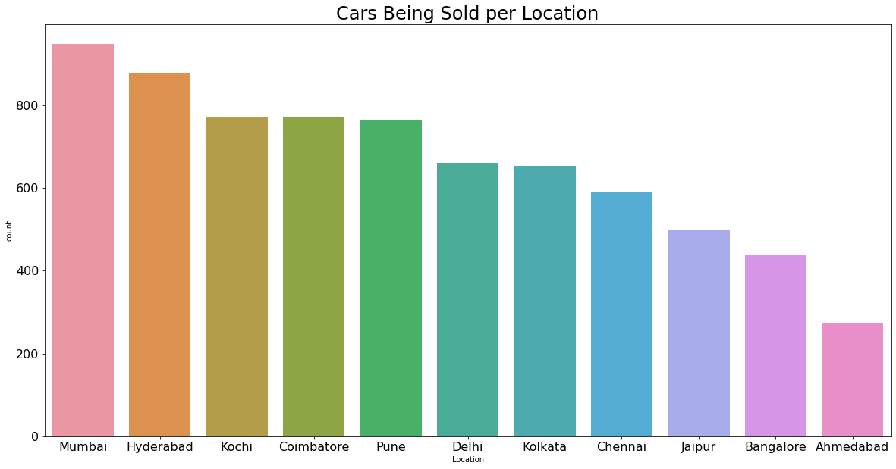
Data Trends – Location
Top selling cities:
1) Mumbai
2) Hyderabad
3) Kochi

Slide 6
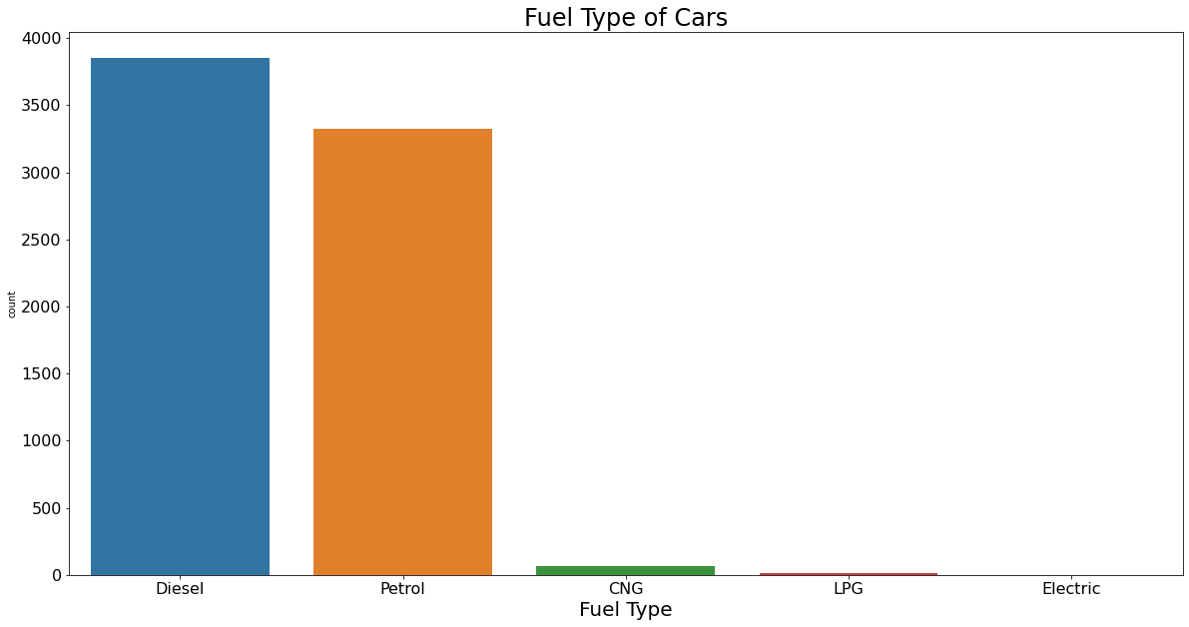
Data Trends – Fuel Type
Diesel and Petrol dominate
the used car market.

Slide 7
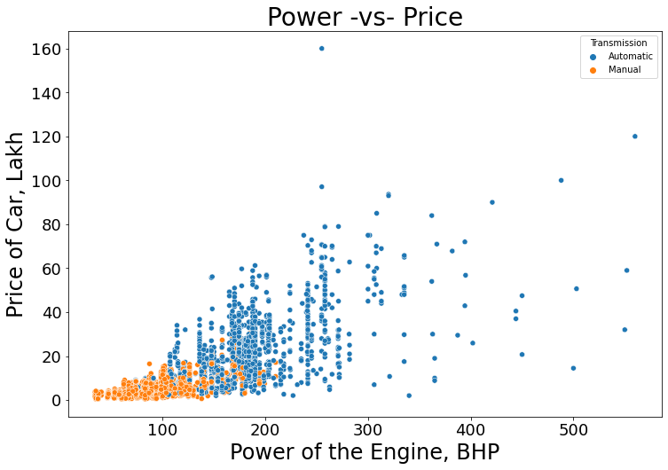
Data Trends – Power
Manual transmission cars sell for much less and are less powerful than Automatics.

Slide 8
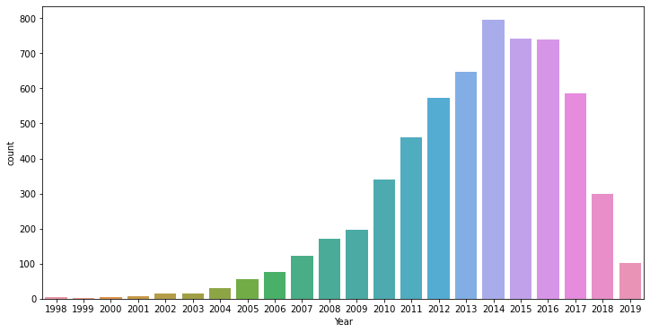
Data Trends – Year
Most used cars on the market now were made after 2010.

Slide 9
Pricing Model
• Machine learning techniques were used to develop and refine a pricing model based on the trends in the data.
• Variance Inflation Factors and p-values were minimized in order to create the most accurate model possible.

Slide 10
Pricing Model
In a nutshell:
• You tell me the following details about the vehicle, and I’ll tell you what price to sell the vehicle for:
Make, Kilometers Driven, Year Manufactured, Mileage, Power, Location of Sale, Number of Owners, Number of Seats, Transmission

Slide 11
Key Pricing Indicators
• Power has a strong positive impact on the price of the vehicle.
• The more power the engine has, the more we can sell the vehicle for.

Slide 12
Key Pricing Indicators
• The age of the vehicle has a strong impact on the price of the vehicle.
• The newest vehicles sell for the most, while older vehicles sell for less.

Slide 13
Key Pricing Indicators
• Some car makes increase the price of the vehicle as you would expect (such as Mini, Land Rover, BMW, and Audi), but it is not as a rule.
• For example, Porsche has a high negative coefficient, indicating that the model predicts that that make lowers the predicted price.

Slide 14
Overall Take-Aways
• Machine learning can find patterns that humans cannot.
• This pricing model will allow us to accurately price our used vehicles, leading to higher sales, and therefore, higher profits.

Slide 15
Room for Improvement?
• More data is required in order to build a reliable model for pricing vehicles with high Power and alternative fuel types.

